Slide 1
MXCuBE | LIMS site report
Wenming Qin
National Facility for Protein Science in Shanghai (NFPSS)
/Shanghai Synchrotron Radiation Facility (SSRF)
November, 2024

Slide 2
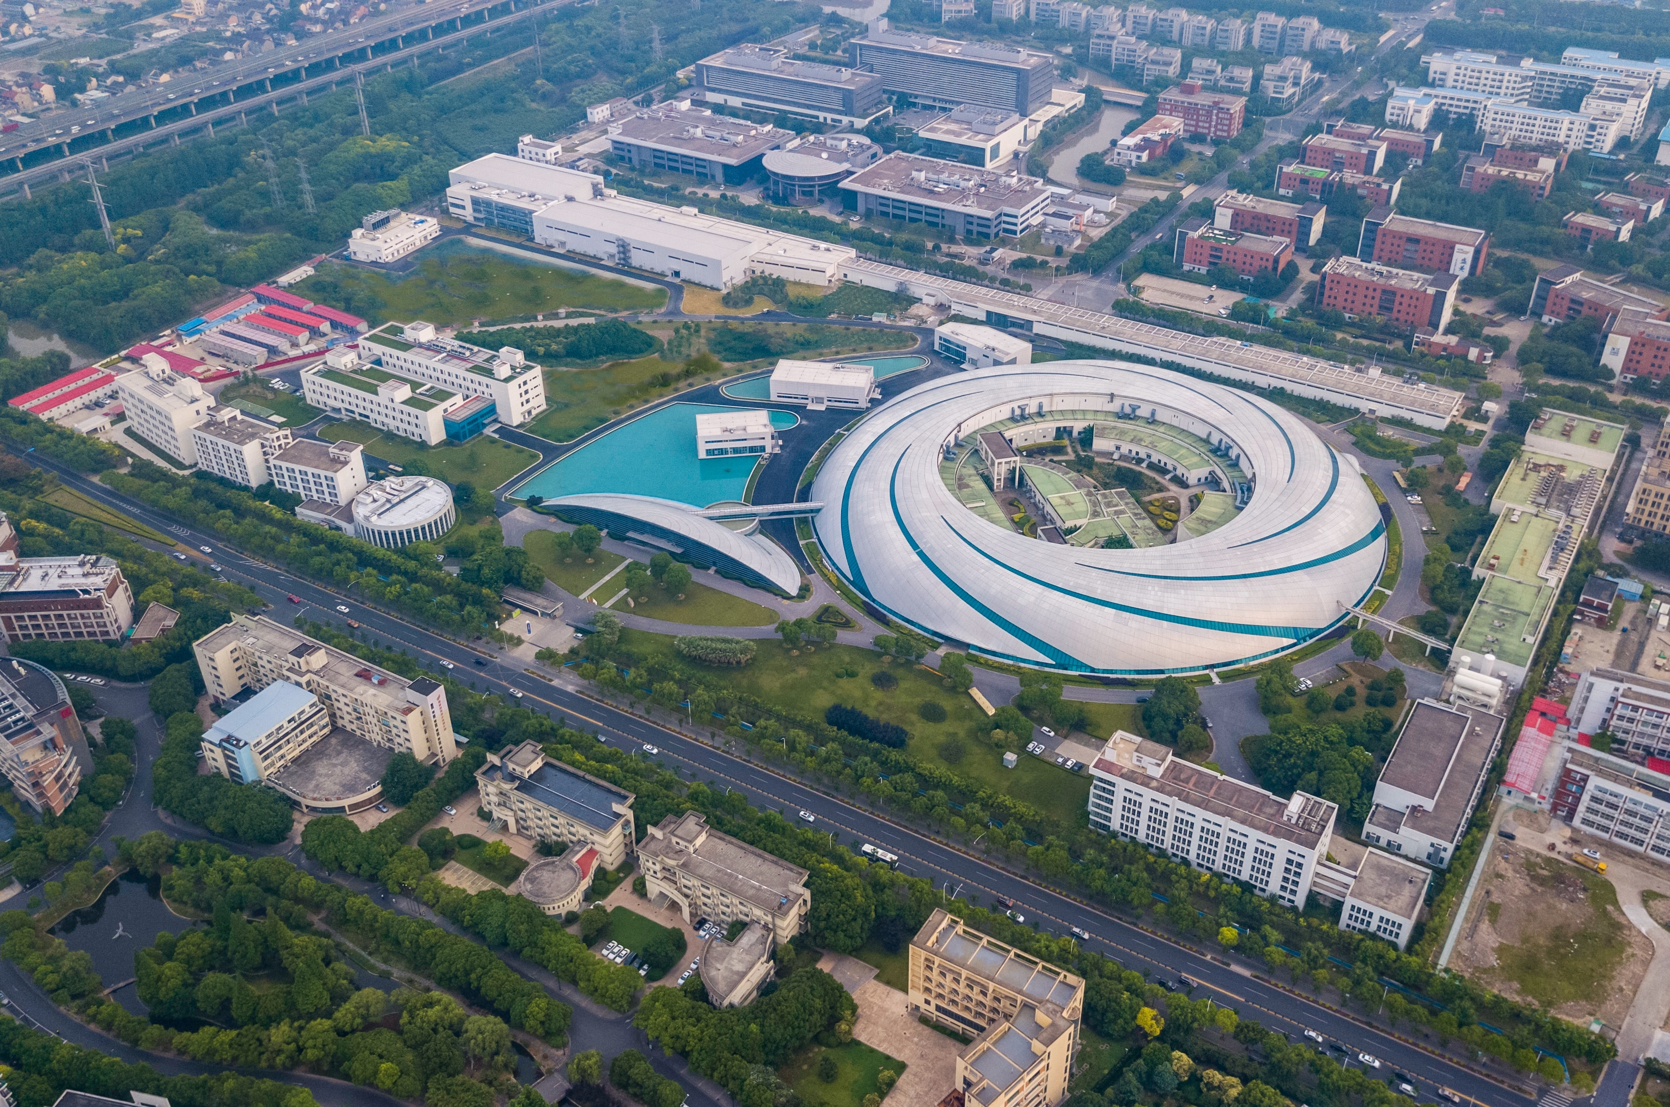
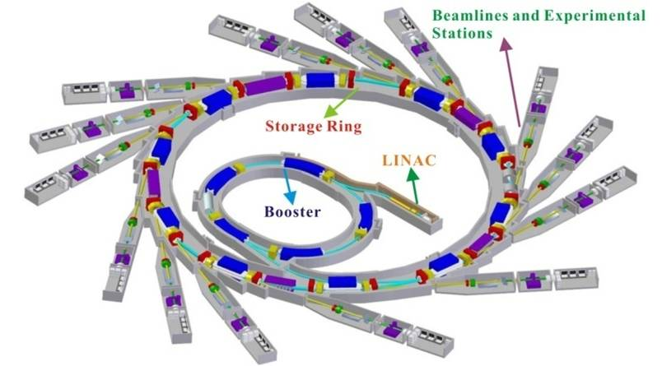
Shanghai Synchrotron Radiation Facility
SSRF Ring Parameters
Electron Energy：3.5 GeV
Electron Current: 300 mA
Circumference: 432 m
Straight sections: 20
Hard X-ray Free Electron Laser
Soft X-ray Free Electron Laser
SSRF

Slide 3

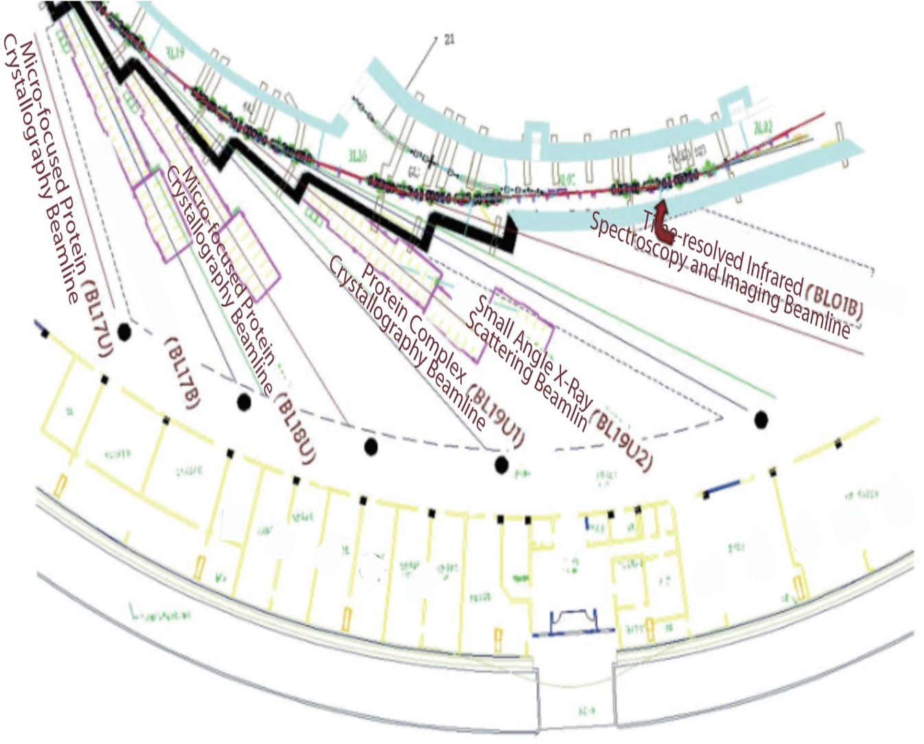
National Facility for Protein Science . Shanghai
NFPS passed the National Acceptance Review, and formally opened to the users in July 2015.
NFPS is composed of 9 technology systems with state-of-the-art instruments in its Haike Road Campus and 5 Beamlines within the Shanghai Synchrotron Radiation Facility.

Slide 4
MX Beamlines at SSRF
BL17B
6 MX Beamlines
BL18U1
NFPSS
MXCube
BL19U1
Shanghai Tech
BL17UM
BL02U1
SSRF
BL10U1

Slide 5
MXCUBE Status
Version of mxcubecore
BL17B : version from 2022.2.23
BL18U : version from 2023.4.9
BL19U1: version from 2023.4.9

Slide 6
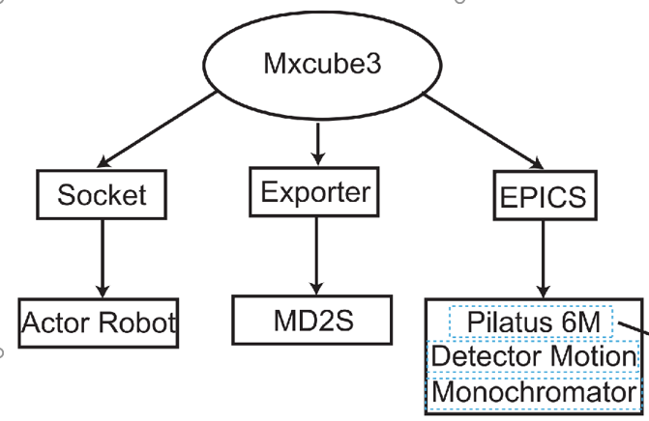
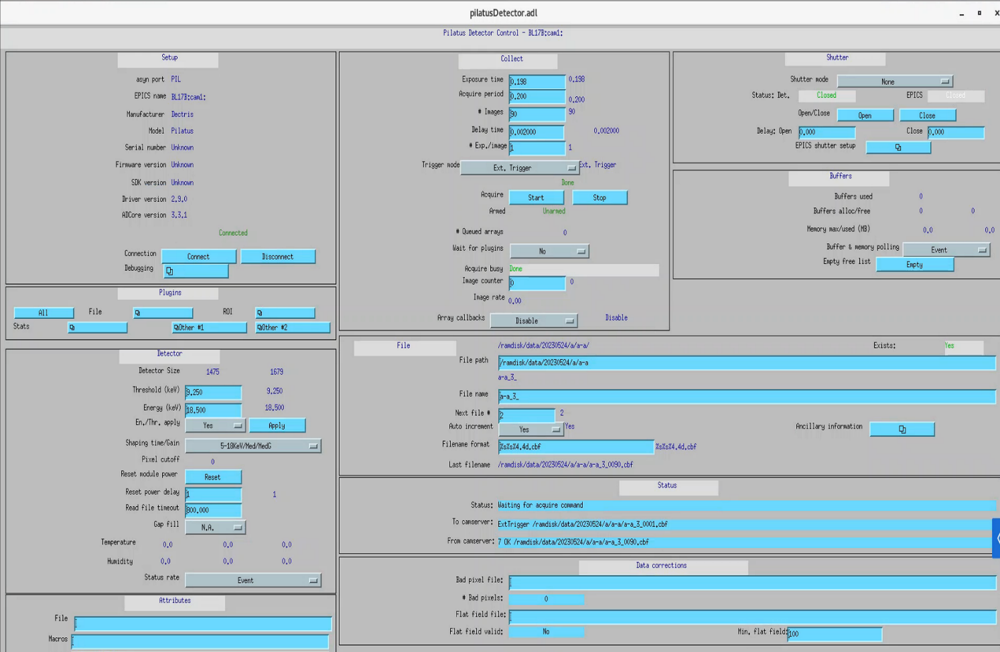
MXCUBE Status
Other development
Integrate Actor sample changer into mxcube.
Use EPICS to control the Pilatus detector.

Slide 7
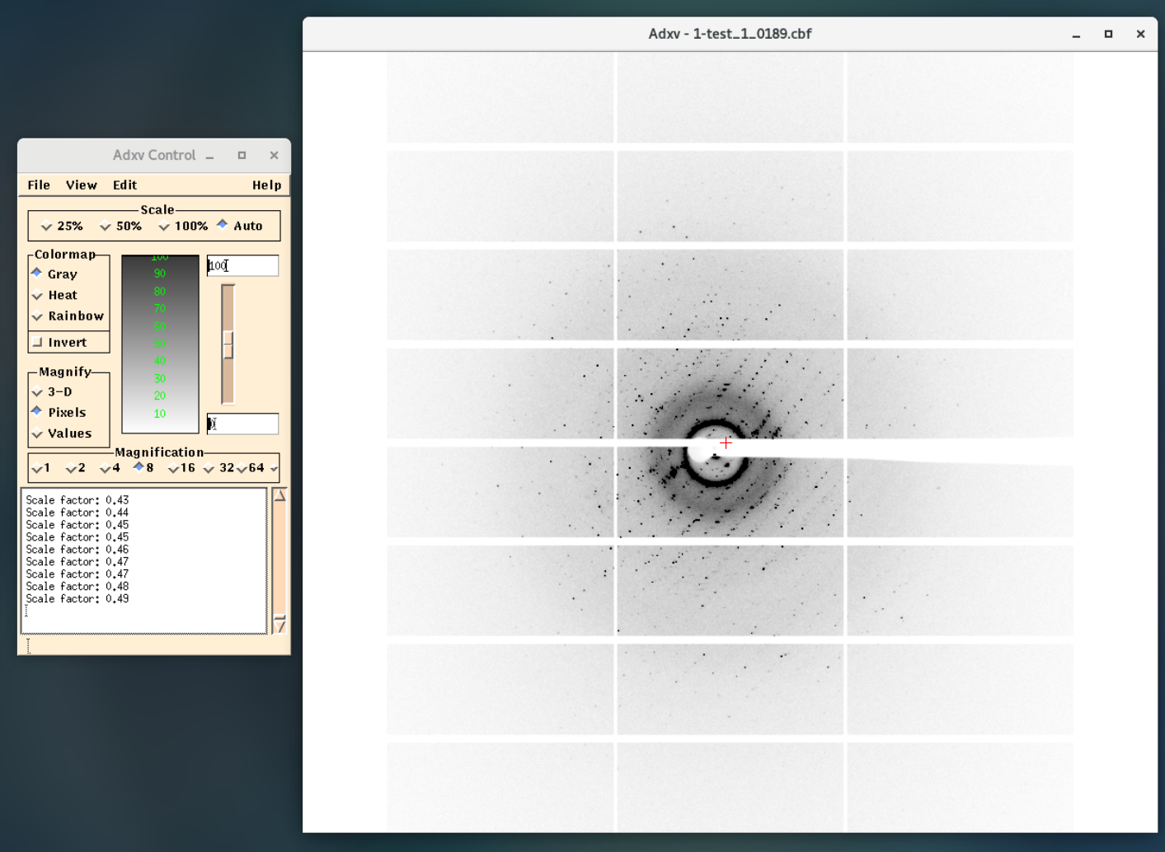
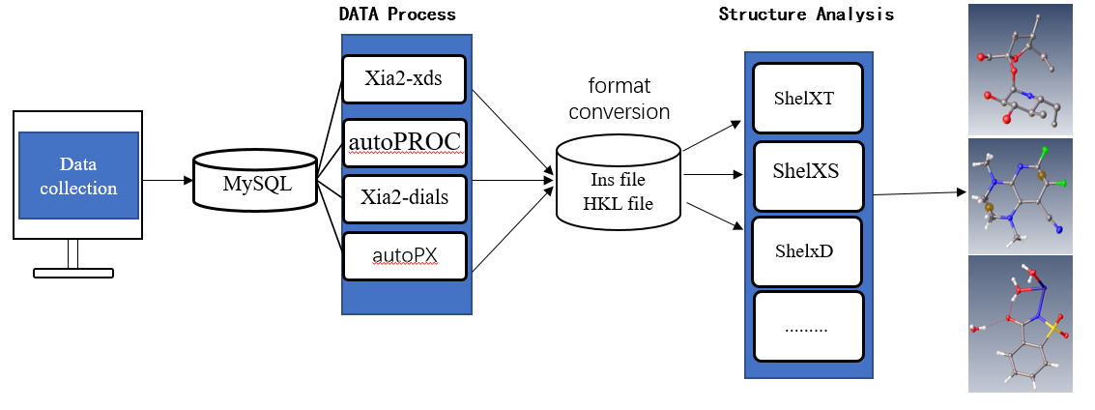
MXCUBE Status
Other development
Auto update diffraction pattern in adxv / Braggy.
Deploy four types of auto processing pipeline.

Slide 8
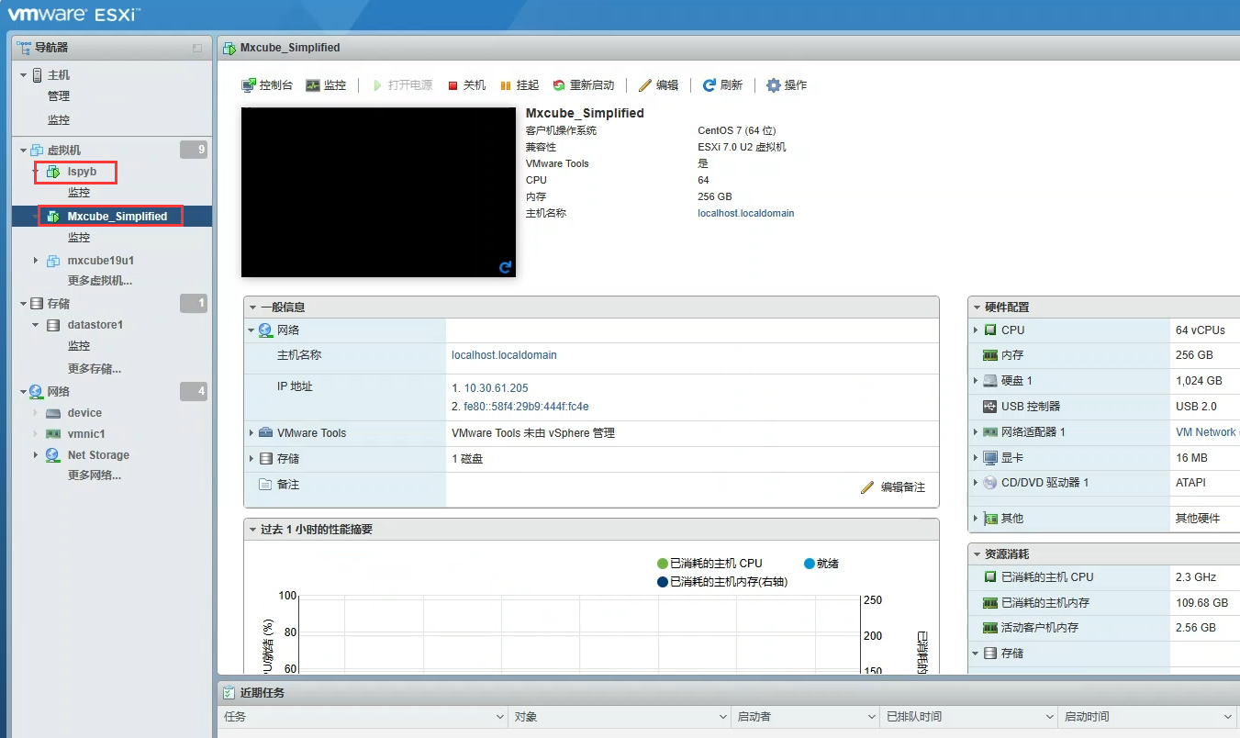
MXCUBE Status
Cybersecurity (virtual machine)
Use VMware to run mxcube and ispyb, take snapshot for insurance.

Slide 9
MXCUBE Status
Cybersecurity (other measures)
Most of servers in beamline only connect to the internal network.
Regular backs up users’ data.

Slide 10
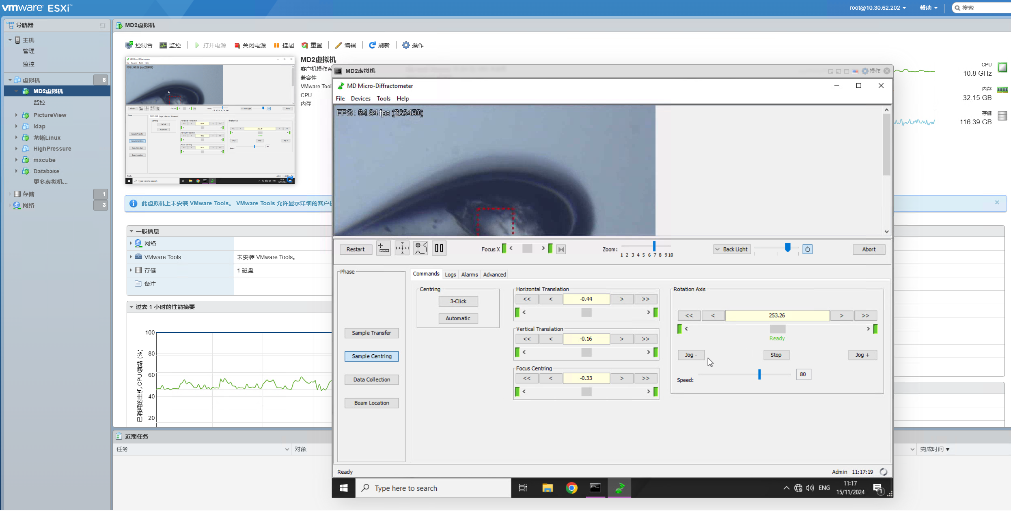
Developments since last meeting
Deploy MD2 computer into virtual machine

Slide 11
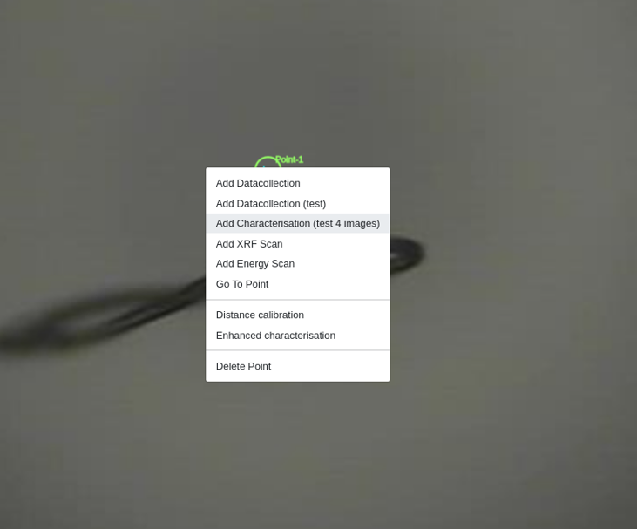
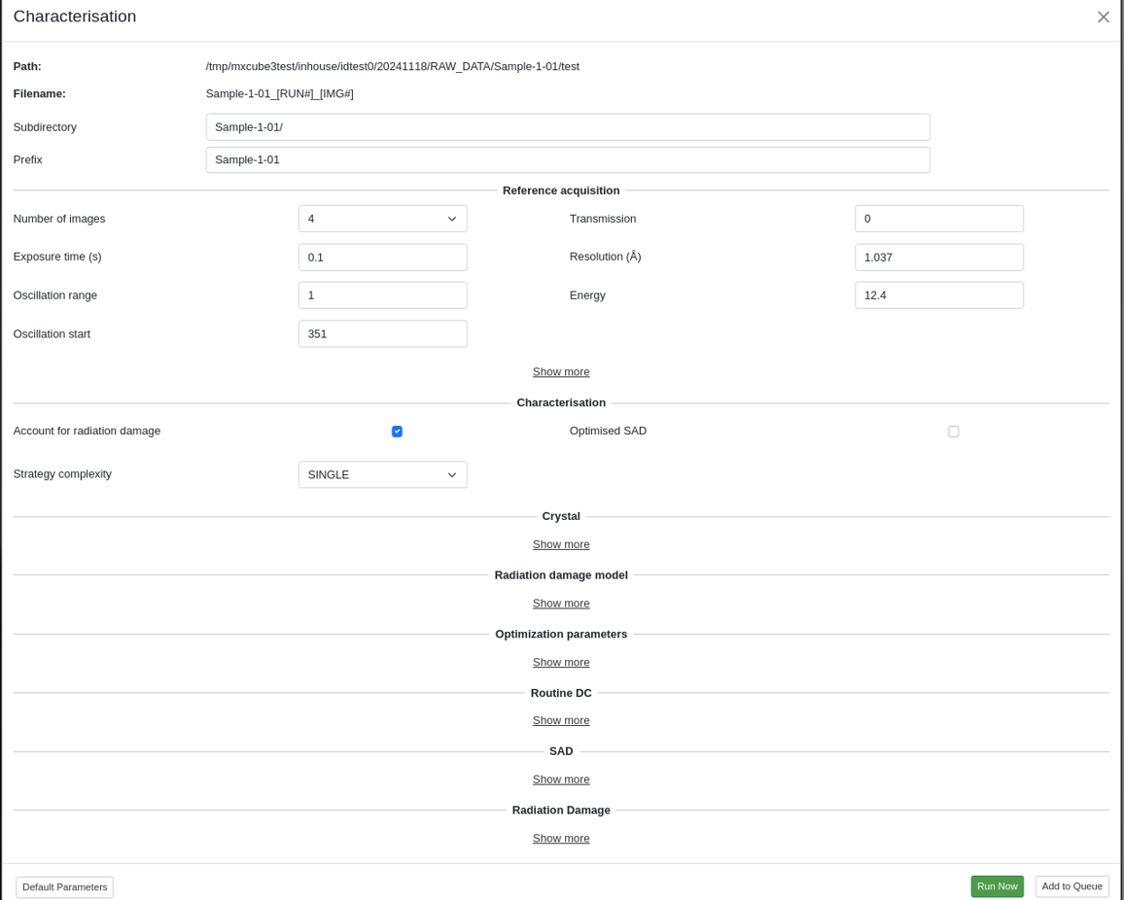
Developments since last meeting
Configure and make characteristic collection available in bl19u1.
( Maybe because that the method we use to control detector from mxcube is through epics,
we found the original code was not suitable ,so we rewrite most of code related to this function.)

Slide 12
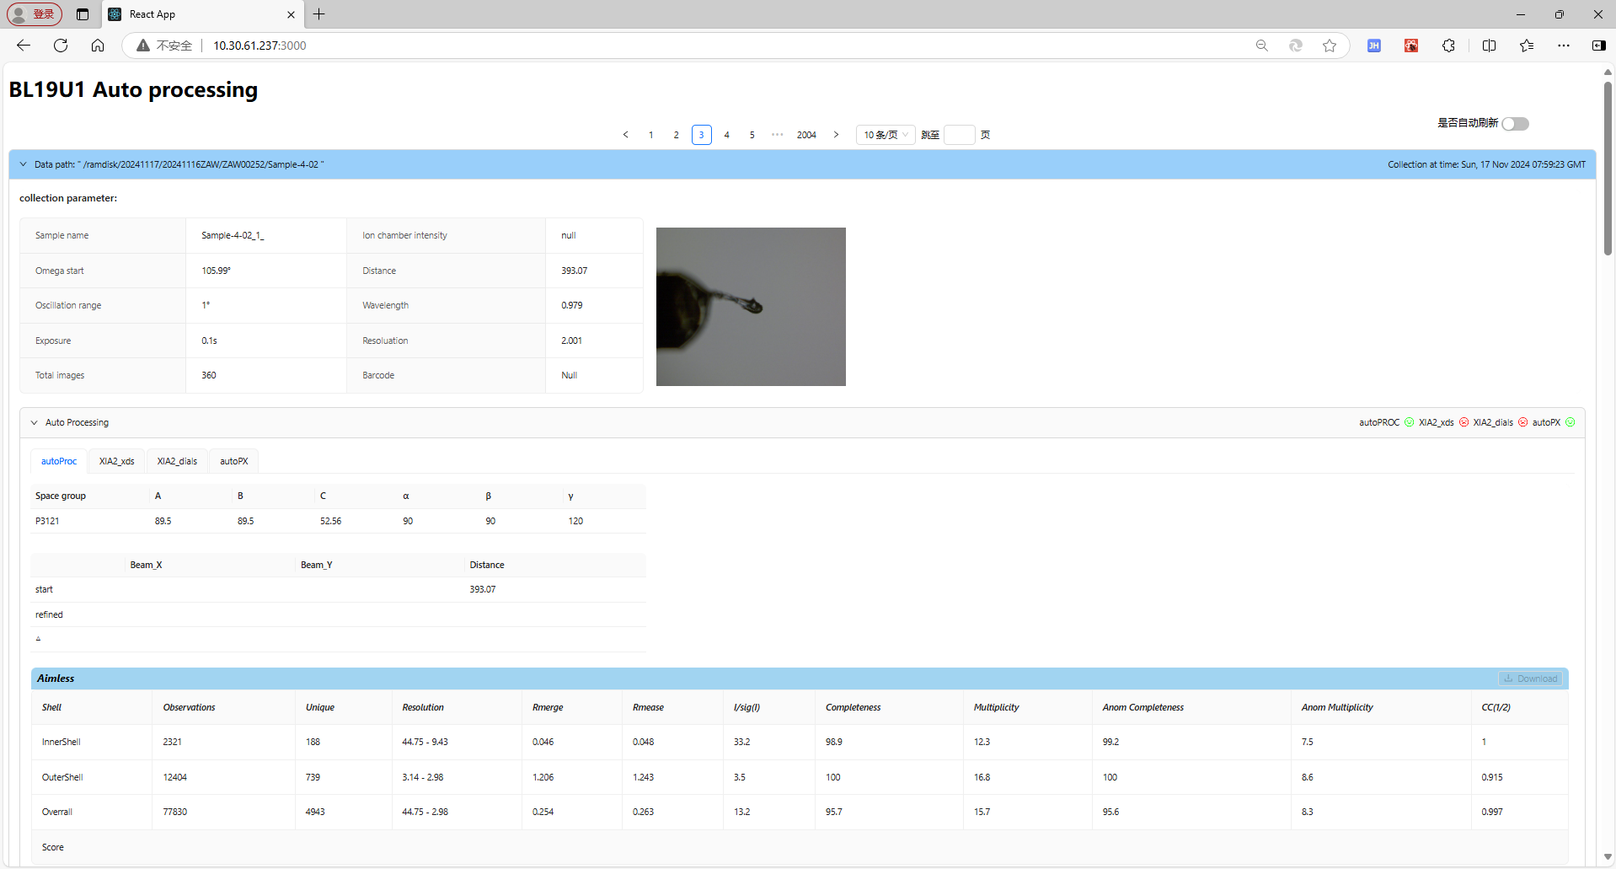
Developments since last meeting
Change the UI of auto processing pipeline.
4 auto processing method
(use the SynchWeb of Diamond Light Source as reference .)

Slide 13
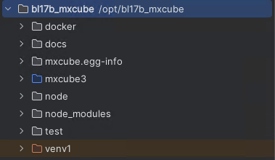
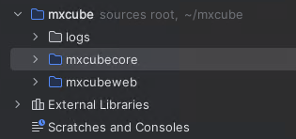
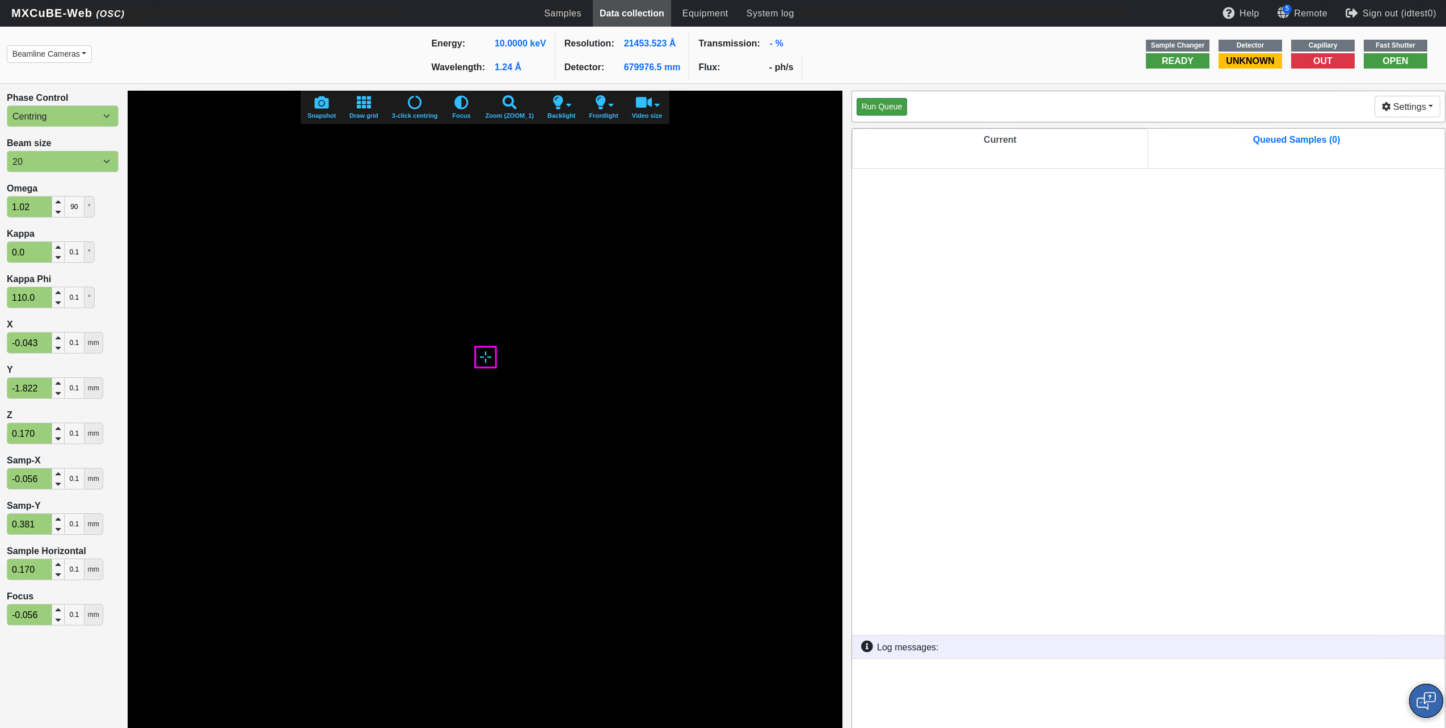
Developments since last meeting
Update the BL17B beamline mxcube to the latest version from 2022.2 to 2024.10.
1.The file structure is clearer.
Old version
New version
2. The front-end has not changed much, and features will be added later as needed.

Slide 14
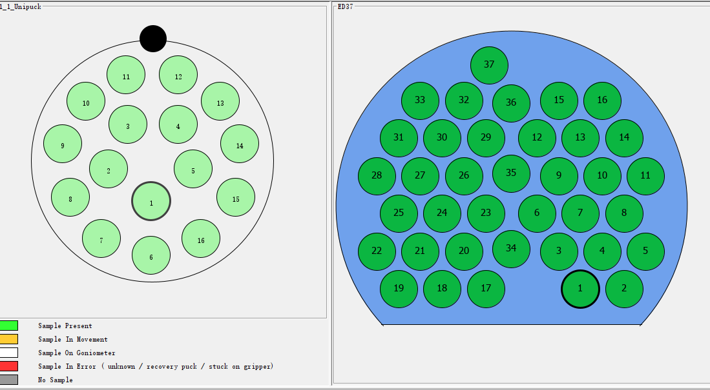
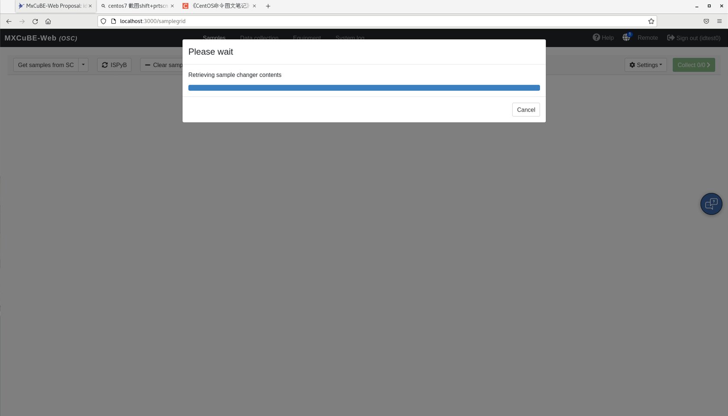
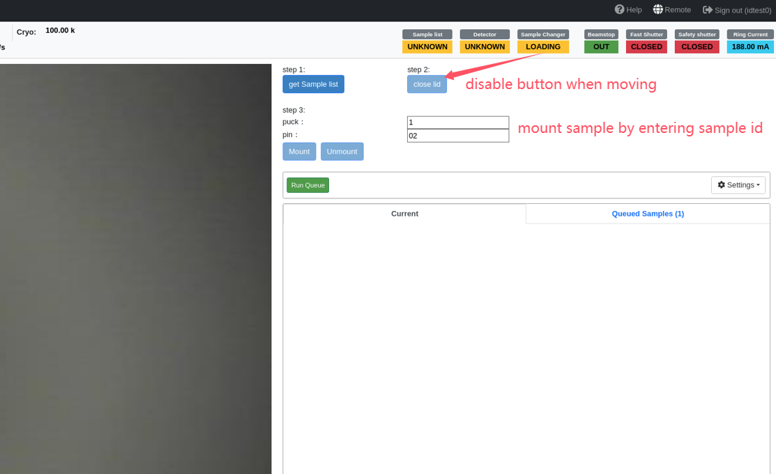
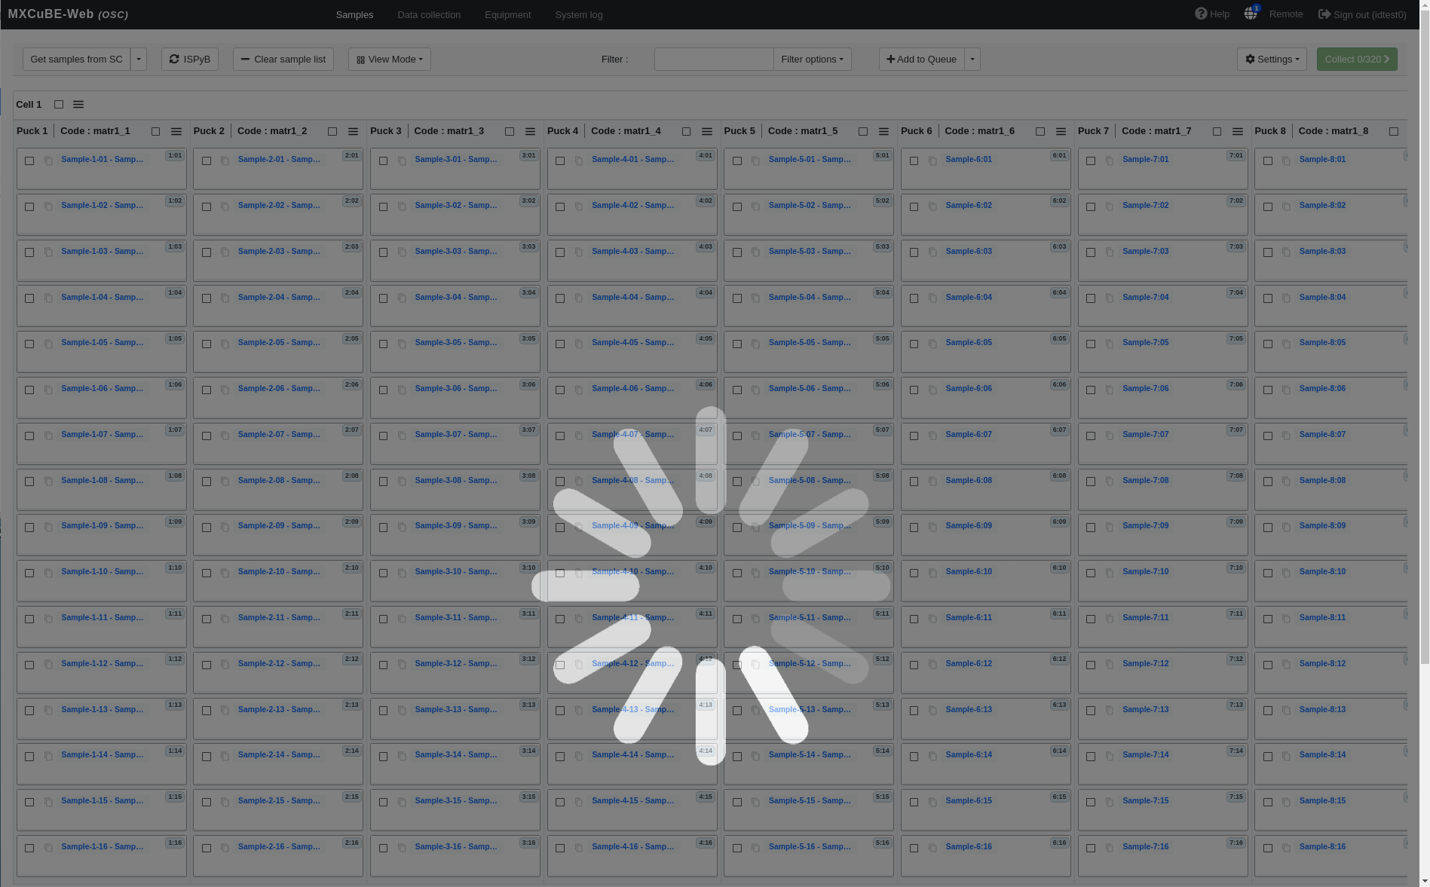
Developments since last meeting
Change the UI of mxcube to prepare for the integration of Flex sample changer
puck number increased to 37
React component may stuck when loading
Mount sample by type the puck and
smaple ID

Slide 15
Developments since last meeting
ISPyB...

Slide 16
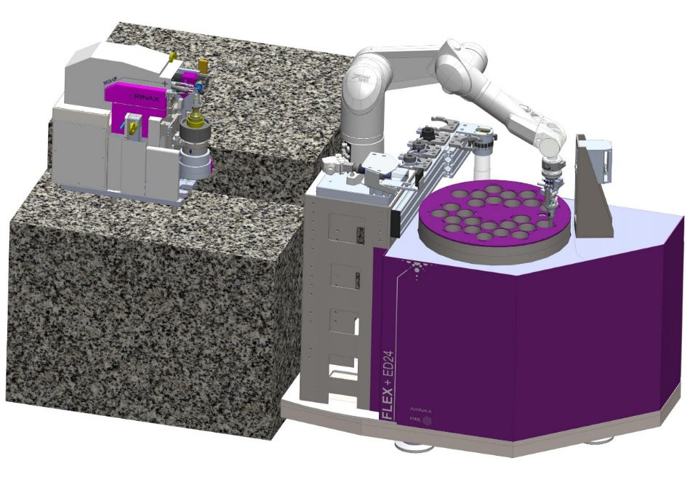
Plans for the next six months
Install FLEX-ED35 from Arinax at BL19U1.
Complete the configuration of ISPyB and connect the database with MXCuBE.
Complete the function of automatic sample mounting, centering and collection.
FLEX-ED35

Slide 17
Thank you for your attention!
Acknowledgments:
- Shanghai Sychrontron Radiation Facility
- Mikel Eguiraun and Jie Nan from MAX IV
- Letícia G. Capovilla from LNLS
- Arinax, Dectris, Rigaku, Irelec
- MXCube community.

